Slide 1
Welcome to React the Definitive Beginner’s Guide
Rami Sayar
Jeremy Foster

Slide 2
Agenda - list all main modules
1
Welcome to React – the Definitive Beginner’s Guide
2
Introduction to Components
3
Handling Data and State with React
4
More React with Routers and Other Add-ons
5
ES2015 with React, Webpack, and Other Tools
6
Connecting Pizza Box App with the Backend

Slide 3
Module 6: Connecting Pizza Box App with the Backend
Rami Sayar
Jeremy Foster

Slide 4
What’s a bot?

Slide 5
Setting up LUIS?

Slide 6
Deploying to Azure Web Apps

Slide 7
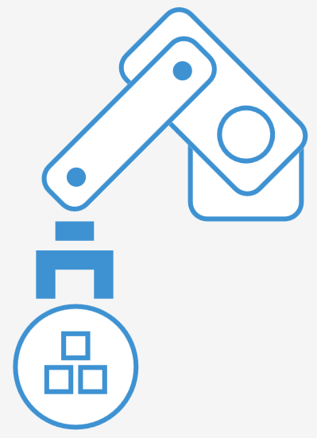
Connecting to the Bot Framework

Slide 8
Building a chat framework

Slide 9
Connecting React to a REST API

Slide 10
Conclusion

